Slide 1


Case Study
Data Analysis

Slide 2


Summarize
Merchant Integration & Profitability:
10 merchants were analyzed to see how they are presenting the financing program to their customers.
Some UX insights were given as well as techniques to available the success of the merchant.
Split test Analysis:
The Intellicron data and Prequals data files were used for analysis and hypothesis test ;
Two proportion Z-Test was used to analyze null and alternative hypotheses.

Slide 3
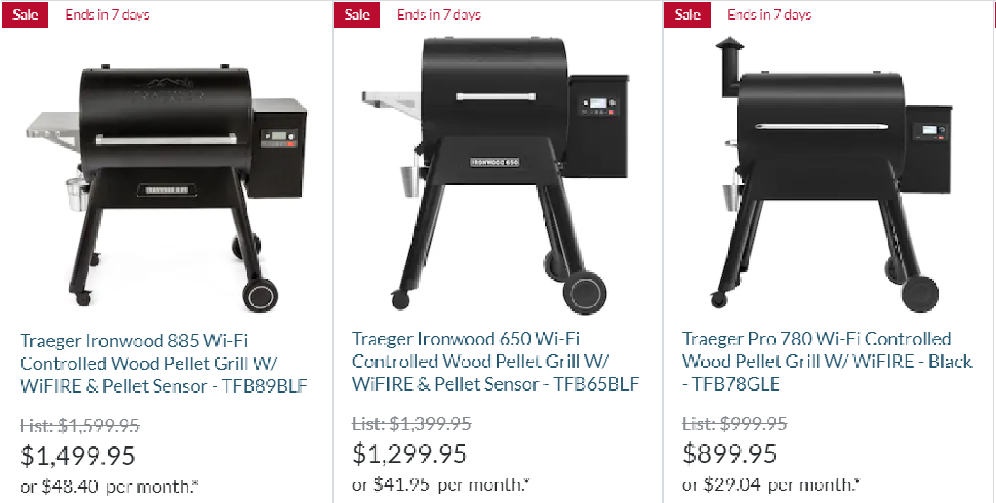


Merchant Integrations & Profitability
1. UX elements for a successful financing program
From our merchant websites, UX like
Information on merchant main page;
Financing option together with the product offer;
would make for a successful financing program.

Slide 4
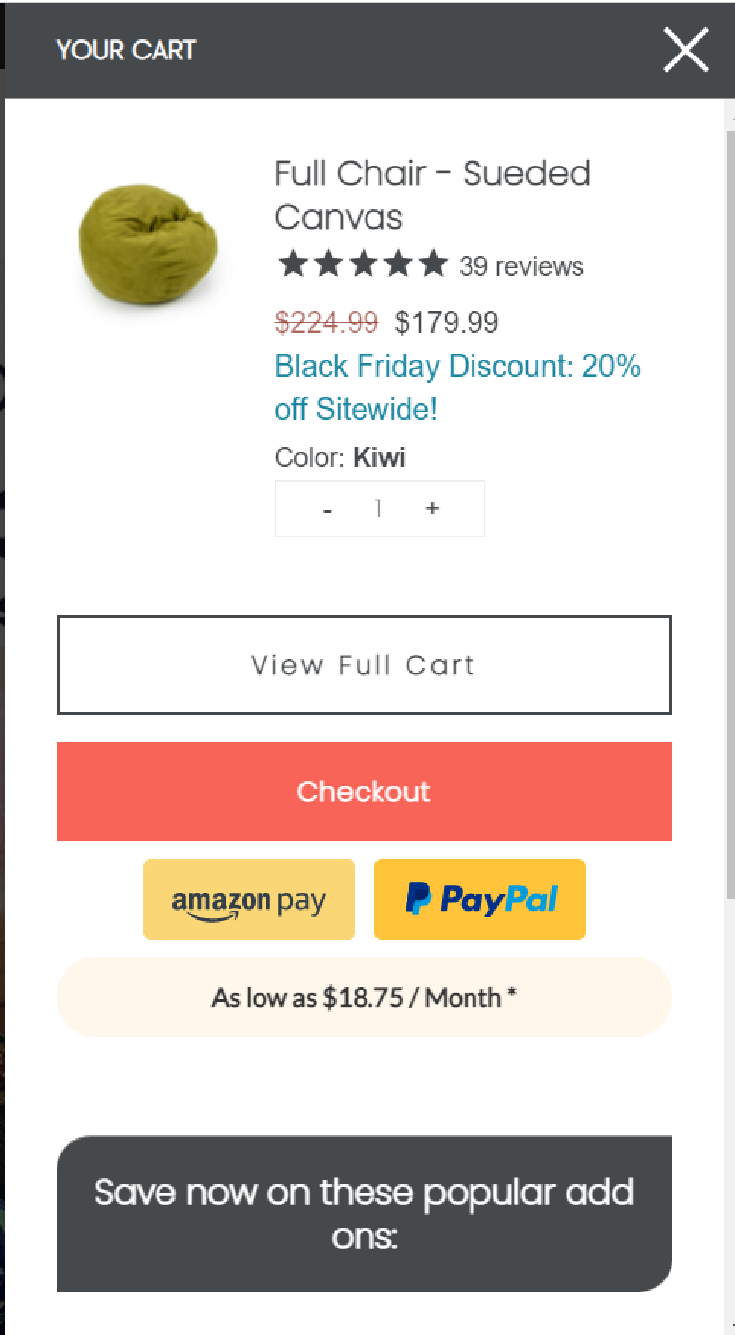

Merchant Integrations & Profitability
1. UX elements for a successful financing program
Some improvement on UX can be done as:
Invest in a great visual design, emphasizing the financial option.
Clear call-to-action.
Display financing program even before checkout.
Needs to be more noticeable

Slide 5

Merchant Integrations & Profitability
2. Measure of merchant’s success and metrics
Measure of a merchant success can be done by analyzing the sales data, comparing to past sales and identifying Growth trends, as well as using metrics such as:
Net profit margin ratio.
Conversion rate.
Volume of customer it brings to Bread.
Review and compare previous performance Vs current.

Slide 6
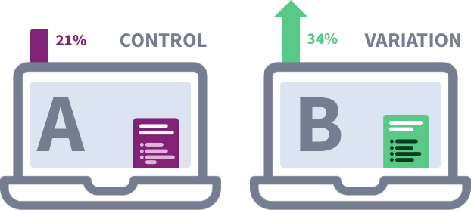
Merchant Integrations & Profitability
3. If you were to design a split test to test these hypotheses, what would it look like?
A/B test comparing merchant websites with better UX elements.
Control Landing page:
Financing program only on check Out;
Option not highlighted.
Variant (“test”) Landing page:
Financing program on main page;
Product price with financing option close and with clear call-to-action
During the test period, 50% of users will be directed to the new landing page.
H₀: Converted status and new UX elements are independent
H_{A}: Converted status and new UX elements are not independent

Slide 7
Merchant Integrations & Profitability
4. . If you were not able to field a split test but asked to test your hypotheses without one,
what data would you need and what method would you use? Please be specific.
Pre and Post data would be needed to evaluate if the new UX elements are impacting the converted rate.
Process a qualitative analysis of the difference rates, for example, click through rates and conversion rates, between the pre and post data.
Did new landing page increase the conversion rate?
How large are the differences between the pages?
What does it say about the landing page?
Consider seasonality on analysis and comparing same months across years (for example, Nov/20 Vs Nov/21) or same weeks across months.

Slide 8
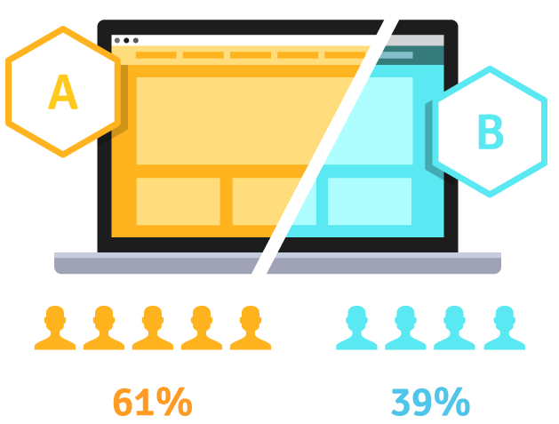

Merchant Integrations & Profitability
5. Trade-offs Split test Vs Pre-Post Analysis
Advantage
Disadvantage
Accuracy
More insights
Control over risk
Expensive
Susceptible to Data Leakage
Split test
Cheaper
Faster to implement
Inaccurate due to seasonality
Pre-Post

Slide 9

Merchant Integrations & Profitability
6. Beyond volume, why some merchants are more profitable than others for Bread?
Some merchants may have customers with lower default rates. This may be because they may have products that appeal to people in a higher income bracket. For example home furnishing loans appeal to older working professionals, compared to electronic gadget loans that appeal to younger, non working, borrowers.
Merchants may also have products that are more of a necessity than a luxury. This would affect the adoption of Bread’s financing program.

Slide 10
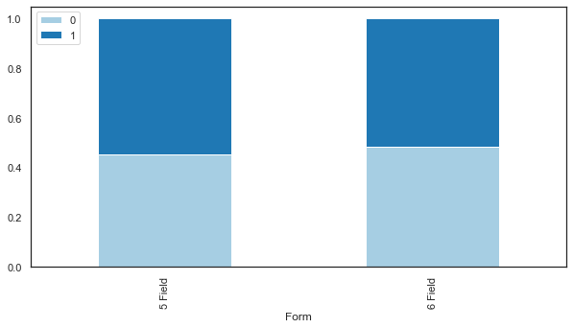
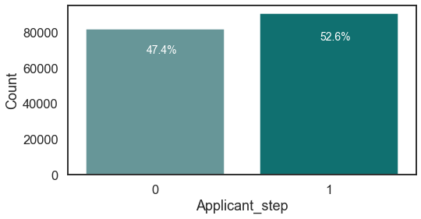


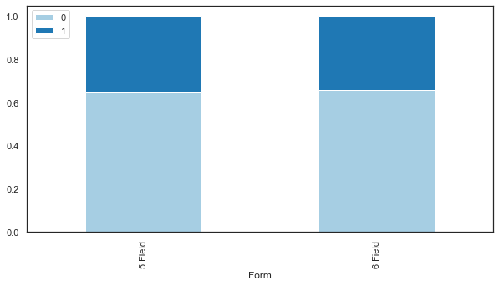
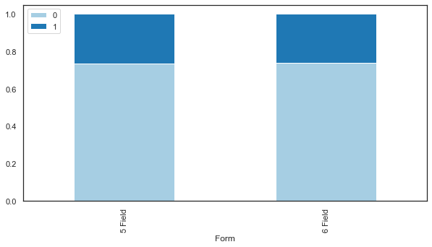

Split Test
Analysis
Conversion Rate – Application step
Conversion Rate – AB test period
Conversion Rate – Before AB Test
0.545
0.517
Global Conversion Rate
% completed the step
53%
Applicantion step
5 Fields
6 Fields
Application step
Form
34%
What was the impact from implementing Intellicron?
Conversion Rate – AB test period
Approved step
Approved step
Check Out step
Impact from implementing:
Conversion Rate improved 2.85%, meaning that more users completed the form;
We need to analyze revenue to see the financial impact, considering the $2 for each customer
0.352
0.340
0.266
0.2620
26%
Check out step
5 Fields
6 Fields
5 Fields
6 Fields
Form
Form

Slide 11
Split Test Analysis
Result of the hypothesis test
H₀: Conversion rate did not increase for New landing page
H_{A}: Conversion rate did increase for New landing page
P_value = 0.001 shows a strong evidence in favor if the alternative hypothesis.
Confidence interval = 95%
Was test and control group assignment done correctly?
Test and control group was not assignment correctly. Form with 5 field was done by 8,609 loading Vs 9,764 loading from form with 6 field, 50% of forms was expected to load as a 5-field form.
Next test, I suggest a better control of split.

Slide 12
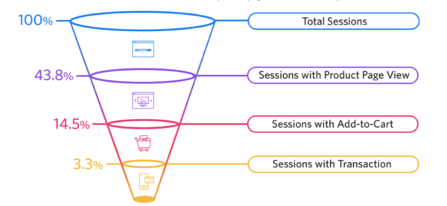
Split Test Analysis
Should we implement Intellicron? What other data, would you need to make this determination?
6-Fields Form
5-Fields Form
Prequalification form
51.7%
Application step
54.5%
34.0%
Approval step
35.2%
-25.5
-27.9
26.2%
Check Out step
26.6%
Intellicron raises in 2.85% the conversion rate on the Applicant step, plus $2 cost per customer analyzed (We can do a revenue Vs cost analysis).
Considering the Check Out Overall rate, we can see that 5-Fields (26.6%) conversion rate Vs 6-Fields (26.2%) did not improve.
Customers that informed their SSN are more like hood to finalize the purchase (2.4%)
Therefore, improving the applicant step is not representing more customer and revenue for Bread.

Slide 13
Split Test Analysis
Should we implement Intellicron? What other data, would you need to make this determination?
6-Fields Form
5-Fields Form
Prequalification form
51.7%
Application step
54.5%
34.0%
Approval step
35.2%
-25.5
-27.9
26.2%
Check Out step
26.6%
Intellicron increases the Conversion rate on the Applicant step by 2.85%. This increase is significant with 95% confidence (p-value = 0.0001).
However, off the customers that applied through Intellicron, 48.8% completed checkout, where as 50.67% completed check out without going through Intellicron. This drop of 1.87% is also significant with 95% confidence (p-value = 0.0328).
This insight is confirmed in the Check Out rate, where the increase of 0.4% is not significant with 95% confidence (p-value=0.2571).

Slide 14
Split Test Analysis
Should we implement Intellicron? What other data, would you need to make this determination?
6-Fields Form
5-Fields Form
Prequalification form
51.7%
Application step
54.5%
34.0%
Approval step
35.2%
-25.5
-27.9
26.2%
Check Out step
26.6%
Customers that provide their SSN are more likely to complete checkout (2.4%)
Therefore, improving the applicant step is not significantly increasing checkout rate.
It could be that customers that wish to purchase more expensive products do not wish to provide their SSN. This may significantly increase the overall Revenue realized by applying Intellicron. An analysis of revenue-per-customer would be required to confirm this hypothesis.

Slide 15
Thank you!
Amanda Mendonca

